Slide 1
String
A C# string (== System.String) is an immutable (unchangeable) sequence of characters.
The simplest way to construct a string is to assign a literal.
string s = "Hello";

Slide 2
Example
string myString==”This is dotnet lab”;
char[ ] separator={‘ ’};
string[ ] myWords=myString.Split(separator);
string takeSubString = myString.Substring(0,10);
stringmyString=”A string”;
char[ ] myChars=myString.ToCharArray();
stringconvertToLower=myString.ToLower();
int length=myString.Length;

Slide 3
Array
An array represents a fixed number of variables (called elements) of a particular type.
The elements in an array are always stored in a contiguous block of memory, providing highly efficient access.
An array is denoted with square brackets after the element type.
type[ ] arrayName;
For example:
char[] vowels = new char[5]; // Declare an array of 5 characters
The Length property of an array returns the number of elements in the array.

Slide 4
Contd…
An array initialization expression to declare and populate an array in a single step:
char[] vowels = new char[] {'a','e','i','o','u'};
OR char[] vowels = {'a','e','i','o','u'};
All arrays inherit from the System.Array class, providing common services for all arrays.
These members include methods to get and set elements regardless of the array type.

Slide 5
Multidimensional Arrays
Multidimensional arrays come in two varieties: rectangular and jagged.
Rectangular arrays represent an n-dimensional block of memory, and jagged arrays are arrays of arrays.
Rectangular arrays:
Rectangular arrays are declared using commas to separate each dimension.
The following declares a rectangular two-dimensional array, where the dimensions are
3 by 3:
int[,] matrix = new int[3,3];

Slide 6
Jagged Arrays
Jagged arrays are declared using successive square brackets to represent each dimension.
A jagged array in C# is an array whose elements are arrays.
The elements of a jagged array can be of different dimensions and sizes.
A jagged array is sometimes called an "array of arrays."
The following is a declaration of a single-dimensional array that has three elements, each of which is a single-dimensional array of integers:
int[][] matrix = new int[3][];

Slide 7
Bounds Checking
All array indexing is bounds-checked by the runtime.
An IndexOutOfRangeException is thrown if we use an invalid index:
int[] arr = new int[3];
arr[3] = 2; // IndexOutOfRangeException thrown

Slide 8
Square brackets also index the array, accessing a particular element by position:
vowels [0] = 'a';
vowels [1] = 'e';
vowels [2] = 'i';
vowels [3] = 'o';
vowels [4] = 'u';

Slide 9
System Collection
System.Collections namespace in the .NET Framework Class Library is the primary source for nongeneric collections.
These classes provide standard implementations of many of the data structures with collections that store references of type object.
Classes are ArrayList, Stack and Hashtable.
The .NET Framework provides a standard set of types for storing and managing collections of objects.
These include resizable lists, linked lists, and sorted and unsorted dictionaries, as well as arrays.

Slide 10
ArrayList
The .NET Framework’s ArrayList collection class mimics the functionality of conventional arrays and provides dynamic resizing of the collection through the class’s methods.
ArrayLists store references to objects.
All classes derive from class object, so an ArrayList can contain objects of any type.
Conventional arrays have a fixed size—they cannot be changed dynamically to conform to an app’s execution-time memory requirements. In some apps, this fixed-size limitation presents a problem

Slide 11
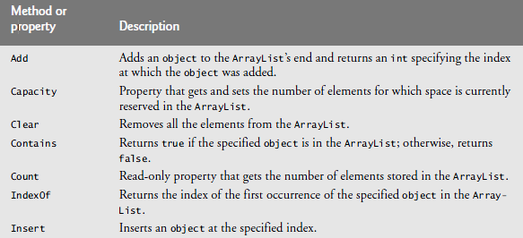
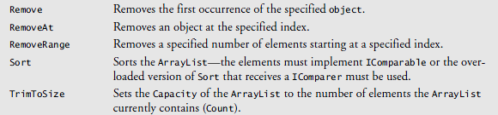

Slide 12
Delegates
A delegate is a type that enables us to store references to functions.
Delegates are declared much like functions, but with no function body and using the delegate keyword.
The delegate declaration specifies a function signature consisting of a return type and the parameter list.
A delegate dynamically wires up a method caller to its target method.
There are two aspects to a delegate: type and instance.

Slide 13
Contd…
A delegate type defines a protocol to which the caller and target will conform, comprising a list of parameter types and a return type.
A delegate instance is an object that refers to one (or more) target methods conforming to that protocol.

Slide 14
Event
An event is a mechanism via which a class can notify its clients when something happens.
Events are certain actions that happen during execution of program that the application wishes to be notified about, so it can respond.
Events are declared using delegates.
For example when you click a button, a button-click-event notification is sent system. Event can be mouse click.
An event is a construct that exposes just the subset of delegate features required for the broadcaster/ subscriber model. The main purpose of events is to prevent subscribers from interfering with each other.

Slide 15
Indexers
Indexers provide a natural syntax for accessing elements in a class or struct that encapsulate a list or dictionary of values.
Indexers are similar to properties, but are accessed via an index argument rather than a property name.

Slide 16
class Sentence
{
string[] words =new string[5];
public string this [intwordNum] // indexer
{
get { return words [wordNum]; }
set { words [wordNum] = value; }
}
}
Here’s how we could use this indexer:
Sentence s = new Sentence();
s[3] = "kangaroo";
Console.WriteLine (s[3]);

Slide 17
Versioning
Versioning is the process of evolving a component over time in a compatible manner.
A new version of a component is source compatible with a previous version if code that depends on the previous version can, when recompiled, work with the new version.
In contrast, a new version of a component is binary compatible if an application that depended on the old version can, without recompilation, work with the new version.

Slide 18
CONTD…
Most languages do not support binary compatibility at all, and many do little to facilitate source compatibility.
In fact, some languages contain flaws that make it impossible, in general, to evolve a class over time without breaking at least some client code.
Versioning in C# through the use of the override and new keywords.
Versioning maintains compatibility between base and derived classes as they evolve.

Slide 19
I/O
In the .NET Framework, the System.IO namespace defines classes for reading and writing files and data streams
It contains types that provide basic file and directory support.
The System.IO namespace, which resides in the mscorlib.dll assembly, provides classes for working with the system I/O and with streams.

Slide 20
Windows Form
We can create a user interface by dragging and dropping controls from a toolbox on windows form
Windows Forms is a rich client API that’s as old as the .NET Framework. Compared to WPF,
Windows Forms is a relatively simple technology that provides most of the features you need in writing a typical Windows application.
It also has significant relevancy in maintaining legacy applications.
It has a number of drawbacks, though, compared to WPF:

Slide 21
Contd…
Controls are positioned and sized in pixels, making it easy to write applications that break on clients whose DPI settings differ from the developer’s.
The API for drawing nonstandard controls is GDI+, which, although reasonably flexible, is slow in rendering large areas (and without double buffering, flickers horribly.
Controls lack true transparency.
Dynamic layout is difficult to get right reliably.

Slide 22
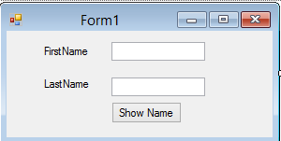
Contd…

